Slide 1
High Performance and Distributed Computing for Big Data
Unit 3: Cloud Computing
Ferran Aran Domingo ferran.aran@udl.cat
Universitat Rovira i Virgili and Universitat de Lleida

Slide 2
High Performance and Distributed Computing for Big Data
What is this course about?

Slide 3
What is this course about?
High Performance and Distributed Computing for Big Data
High Performance
Refers to using supercomputers and parallel processing techniques to solve complex computational
problems.

Slide 4
What is this course about?
High Performance and Distributed Computing for Big Data
High Performance
Refers to using supercomputers and parallel processing techniques to solve complex computational
problems.
Distributed Computing
This concept means using multiple computers that are interconnected and communicate with each
other to achieve a common goal.

Slide 5
What is this course about?
High Performance and Distributed Computing for Big Data
High Performance
Refers to using supercomputers and parallel processing techniques to solve complex computational
problems.
Distributed Computing
This concept means using multiple computers that are interconnected and communicate with each
other to achieve a common goal.
Big Data
This term leads to using large and complex data sets that are diﬀicult to process using traditional
data processing applications.

Slide 6
Who am I?
My name is Ferran Aran, and I’m a Computer Engineer. I’m currently working on my PhD thesis, where I apply Reinforcement Learning to optimize energy consumption in industrial processes. My experience spans both academia and industry, often times applying research to real-world applications.

Slide 7
Who am I?
My name is Ferran Aran, and I’m a Computer Engineer. I’m currently working on my PhD thesis, where I apply Reinforcement Learning to optimize energy consumption in industrial processes. My experience spans both academia and industry, often times applying research to real-world applications.
After earning my degree, I spent a year at Universitat de Lleida, collaborating with a medical clinic to optimize surgery schedules using mathematical models. Then, I joined GFT Technologies, where I’ve been working for the last two years and recently started my PhD research.

Slide 8
Who am I?
My name is Ferran Aran, and I’m a Computer Engineer. I’m currently working on my PhD thesis, where I apply Reinforcement Learning to optimize energy consumption in industrial processes. My experience spans both academia and industry, often times applying research to real-world applications.
After earning my degree, I spent a year at Universitat de Lleida, collaborating with a medical clinic to optimize surgery schedules using mathematical models. Then, I joined GFT Technologies, where I’ve been working for the last two years and recently started my PhD research.
My work involves handling large datasets and developing complex machine learning models, which means I spend a lot of time working with cloud infrastructure and high-performance computing.

Slide 9
Who am I?
My name is Ferran Aran, and I’m a Computer Engineer. I’m currently working on my PhD thesis, where I apply Reinforcement Learning to optimize energy consumption in industrial processes. My experience spans both academia and industry, often times applying research to real-world applications.
After earning my degree, I spent a year at Universitat de Lleida, collaborating with a medical clinic to optimize surgery schedules using mathematical models. Then, I joined GFT Technologies, where I’ve been working for the last two years and recently started my PhD research.
My work involves handling large datasets and developing complex machine learning models, which means I spend a lot of time working with cloud infrastructure and high-performance computing.
Just to clarify! While I’ve worked with healthcare data, I’m not a specialist in Biology, Medicine, or Health. But if you’re curious about distributed computing, Big Data or cloud, I’ve got plenty to share!

Slide 10
Pre-Course Survey: Who are you?
How familiar are you with cloud computing technology?
Pre-Course Survey: Who are you?

Slide 11
Pre-Course Survey: Who are you?
How familiar are you with cloud computing technology?
What is your background, and why did you enrol in this Master’s degree?
Pre-Course Survey: Who are you?

Slide 12
Pre-Course Survey: Who are you?
How familiar are you with cloud computing technology?
What is your background, and why did you enrol in this Master’s degree?
What does cloud computing mean to you?
Pre-Course Survey: Who are you?

Slide 13
Introduction

Slide 14
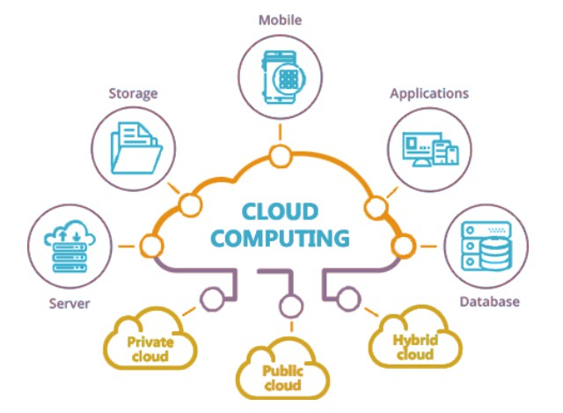
What is Cloud Computing?
Definition
Cloud computing refers to the on-demand delivery of computing services, including servers, storage, databases, software, analytics, and more, over the internet (the cloud) with pay-as-you-go pricing (Mell, Grance, et al. 2011).
Figure 1: Overview of Cloud Computing

Slide 15
What is Cloud Computing?
Definition
Cloud computing refers to the on-demand delivery of computing services, including servers, storage, databases, software, analytics, and more, over the internet (the cloud) with pay-as-you-go pricing (Mell, Grance, et al. 2011).
Vision
In cloud computing, users can access these services remotely from any location with an internet connection. Rather than owning and maintaining their own computing infrastructure or data centers, users and companies can rent access to anything from applications to storage from a cloud service provider.
Figure 1: Overview of Cloud Computing

Slide 16
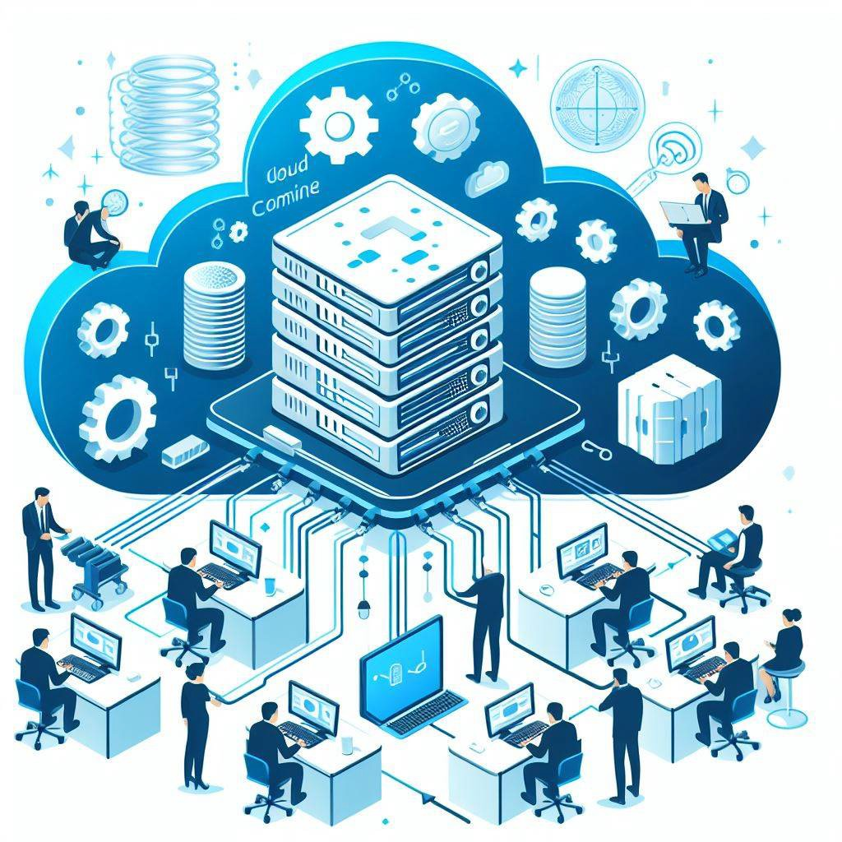
What is the idea behind Cloud Computing?
Infrastructure as Software
Cloud computing enables companies to consume a compute resource, such as a virtual machine (VM), storage, or an application,

Slide 17
What is the idea behind Cloud Computing?
Infrastructure as Software
Cloud computing enables companies to consume a compute resource, such as a virtual machine (VM), storage, or an application, as a utility ⇒ just like electricity, rather than having to build and maintain computing infrastructures in-house.

Slide 18
What is the idea behind Cloud Computing?
Infrastructure as Software
Cloud computing enables companies to consume a compute resource, such as a virtual machine (VM), storage, or an application, as a utility ⇒ just like electricity, rather than having to build and maintain computing infrastructures in-house.
Take Home Message
Stop thinking about the physical infrastructure and start thinking about software.

Slide 19
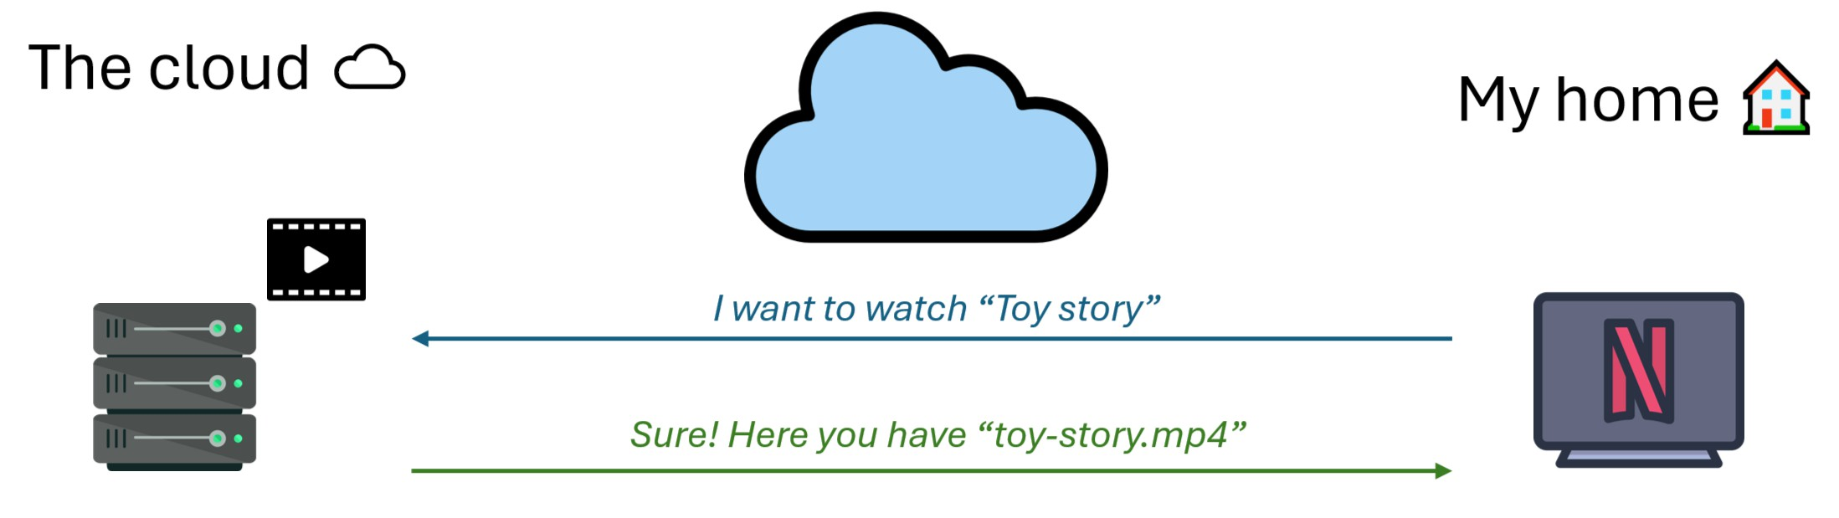
Demystifying the cloud
Figure 2: What happens when I watch Netflix?

Slide 20
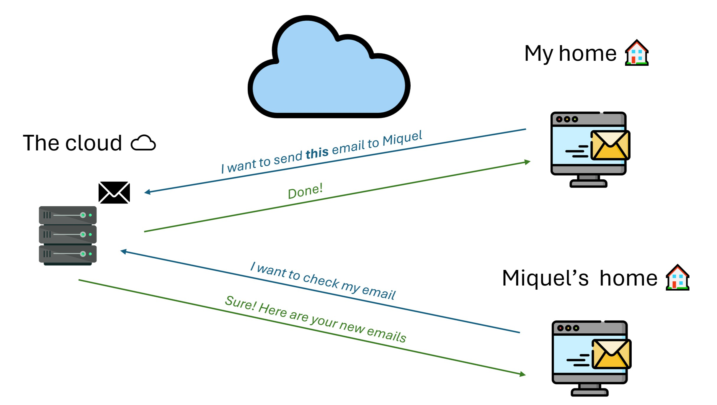
Demystifying the cloud
Figure 3: What happens when I send an email?

Slide 21
Which is the cloud computing model?
Cloud computing is a model for enabling convenient, on-demand network access to a shared pool of configurable computing resources (e.g., networks, servers, storage, applications, and services) that can be rapidly provisioned and released with minimal management effort or service provider interaction.

Slide 22
Which is the cloud computing model?
Cloud computing is a model for enabling convenient, on-demand network access to a shared pool of configurable computing resources (e.g., networks, servers, storage, applications, and services) that can be rapidly provisioned and released with minimal management effort or service provider interaction.
Flexible and scalable.

Slide 23
Which is the cloud computing model?
Cloud computing is a model for enabling convenient, on-demand network access to a shared pool of configurable computing resources (e.g., networks, servers, storage, applications, and services) that can be rapidly provisioned and released with minimal management effort or service provider interaction.
Flexible and scalable.
Pay what you use.

Slide 24
Which is the cloud computing model?
Cloud computing is a model for enabling convenient, on-demand network access to a shared pool of configurable computing resources (e.g., networks, servers, storage, applications, and services) that can be rapidly provisioned and released with minimal management effort or service provider interaction.
Flexible and scalable.
Pay what you use.
Can change and is easy to upgrade.

Slide 25
Which is the cloud computing model?
Cloud computing is a model for enabling convenient, on-demand network access to a shared pool of configurable computing resources (e.g., networks, servers, storage, applications, and services) that can be rapidly provisioned and released with minimal management effort or service provider interaction.
Flexible and scalable.
Pay what you use.
Can change and is easy to upgrade.
No need to buy hardware.

Slide 26
Which is the cloud computing model?
Cloud computing is a model for enabling convenient, on-demand network access to a shared pool of configurable computing resources (e.g., networks, servers, storage, applications, and services) that can be rapidly provisioned and released with minimal management effort or service provider interaction.
Flexible and scalable.
Pay what you use.
Can change and is easy to upgrade.
No need to buy hardware.
Cloud computing is elastic, allowing organizations to scale resources based on demand eﬀiciently.

Slide 27
Which is the traditional computing model?
In traditional computing, the user must buy the hardware and software, and then install them on the computer. The user is responsible for the maintenance and security of the software and hardware.

Slide 28
Which is the traditional computing model?
In traditional computing, the user must buy the hardware and software, and then install them on the computer. The user is responsible for the maintenance and security of the software and hardware.
Requires space for the servers.

Slide 29
Which is the traditional computing model?
In traditional computing, the user must buy the hardware and software, and then install them on the computer. The user is responsible for the maintenance and security of the software and hardware.
Requires space for the servers.
Needs a team of experts for install, configure and maintain.

Slide 30
Which is the traditional computing model?
In traditional computing, the user must buy the hardware and software, and then install them on the computer. The user is responsible for the maintenance and security of the software and hardware.
Requires space for the servers.
Needs a team of experts for install, configure and maintain.
Requires phisical security policies.

Slide 31
Which is the traditional computing model?
In traditional computing, the user must buy the hardware and software, and then install them on the computer. The user is responsible for the maintenance and security of the software and hardware.
Requires space for the servers.
Needs a team of experts for install, configure and maintain.
Requires phisical security policies.
Long hardware procurement process (purchase, install, configure and maintain).

Slide 32
Which is the traditional computing model?
In traditional computing, the user must buy the hardware and software, and then install them on the computer. The user is responsible for the maintenance and security of the software and hardware.
Requires space for the servers.
Needs a team of experts for install, configure and maintain.
Requires phisical security policies.
Long hardware procurement process (purchase, install, configure and maintain).
Requires prediction of the theoretical maximum peak of the system.

Slide 33
Which is the traditional computing model?
In traditional computing, the user must buy the hardware and software, and then install them on the computer. The user is responsible for the maintenance and security of the software and hardware.
Requires space for the servers.
Needs a team of experts for install, configure and maintain.
Requires phisical security policies.
Long hardware procurement process (purchase, install, configure and maintain).
Requires prediction of the theoretical maximum peak of the system.
If the company underestimates the peak, the system will be slow, and the users will be unhappy. If the company overestimates the peak, it will have a lot of unused resources and waste money.

Slide 34
Which is the traditional computing model?
In traditional computing, the user must buy the hardware and software, and then install them on the computer. The user is responsible for the maintenance and security of the software and hardware.
Requires space for the servers.
Needs a team of experts for install, configure and maintain.
Requires phisical security policies.
Long hardware procurement process (purchase, install, configure and maintain).
Requires prediction of the theoretical maximum peak of the system.
If the company underestimates the peak, the system will be slow, and the users will be unhappy. If the company overestimates the peak, it will have a lot of unused resources and waste money.
What happens if you need to change or upgrade the hardware?

Slide 35
What is the difference between living in a hotel and owning a house?
Live in a hotel vs. Own a house

Slide 36
Live in a hotel vs. Own a house
What is the difference between living in a hotel and owning a house?
In a hotel, you pay for what you use, and you do not need to worry about the maintenance of the building.

Slide 37
Live in a hotel vs. Own a house
What is the difference between living in a hotel and owning a house?
In a hotel, you pay for what you use, and you do not need to worry about the maintenance of the building.
In a house, you have to buy the house, and then you have to maintain it.

Slide 38
Live in a hotel vs. Own a house
What is the difference between living in a hotel and owning a house?
In a hotel, you pay for what you use, and you do not need to worry about the maintenance of the building.
In a house, you have to buy the house, and then you have to maintain it.
What is the difference between cloud and traditional computing?

Slide 39
Live in a hotel vs. Own a house
What is the difference between living in a hotel and owning a house?
In a hotel, you pay for what you use, and you do not need to worry about the maintenance of the building.
In a house, you have to buy the house, and then you have to maintain it.
What is the difference between cloud and traditional computing?
In cloud computing, you pay for what you use, and you do not need to worry about the maintenance of the hardware.

Slide 40
Case Study: Serving a Personal Website
Which are the steps to serve a personal website in traditional computing?

Slide 41
Case Study: Serving a Personal Website
Which are the steps to serve a personal website in traditional computing?
You have to buy a server, install the operating system, install the web server, configure the web server, and then upload the website.

Slide 42
Case Study: Serving a Personal Website
Which are the steps to serve a personal website in traditional computing?
You have to buy a server, install the operating system, install the web server, configure the web server, and then upload the website.
What is the advantatge of using cloud computing?

Slide 43
Case Study: Serving a Personal Website
Which are the steps to serve a personal website in traditional computing?
You have to buy a server, install the operating system, install the web server, configure the web server, and then upload the website.
What is the advantatge of using cloud computing?
The user does not need to buy the server, the user can rent the server and the web server (cloud provider responsibility), and then upload the website (user responsibility).

Slide 44
Which are the main cloud computing services models?

Slide 45
Which are the main cloud computing services models?
Infrastructure as a Service (IaaS): Provides virtualized computing resources over the internet.

Slide 46
Which are the main cloud computing services models?
Infrastructure as a Service (IaaS): Provides virtualized computing resources over the internet.
Platform as a Service (PaaS): Provides a platform allowing customers to develop, run, and manage applications without the complexity of building and maintaining the infrastructure.

Slide 47
Which are the main cloud computing services models?
Infrastructure as a Service (IaaS): Provides virtualized computing resources over the internet.
Platform as a Service (PaaS): Provides a platform allowing customers to develop, run, and manage applications without the complexity of building and maintaining the infrastructure.
Software as a Service (SaaS): Provides software applications over the internet on a subscription basis.

Slide 48
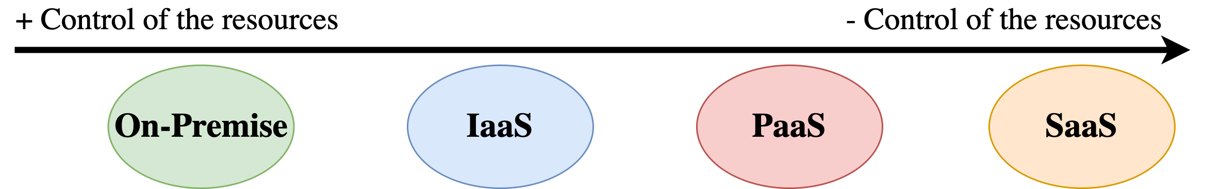
Which are the main cloud computing services models?
Infrastructure as a Service (IaaS): Provides virtualized computing resources over the internet.
Platform as a Service (PaaS): Provides a platform allowing customers to develop, run, and manage applications without the complexity of building and maintaining the infrastructure.
Software as a Service (SaaS): Provides software applications over the internet on a subscription basis.
Figure 4: Cloud Services Models

Slide 49
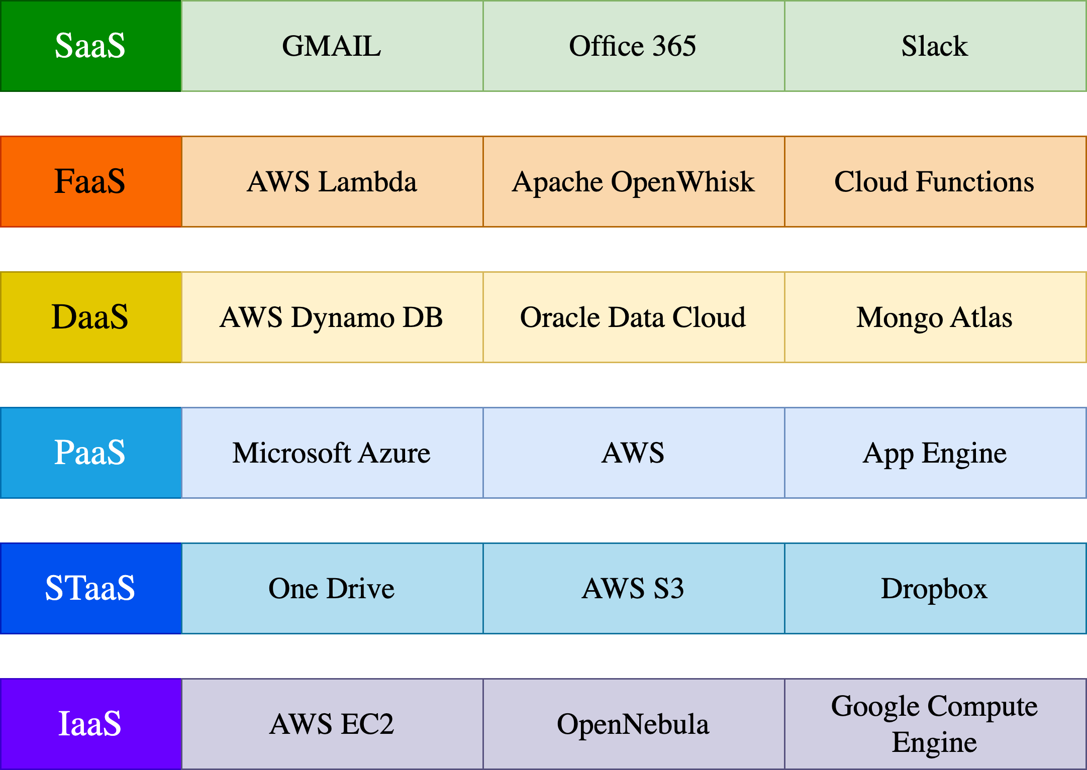
Examples of Cloud Computing Models

Slide 50
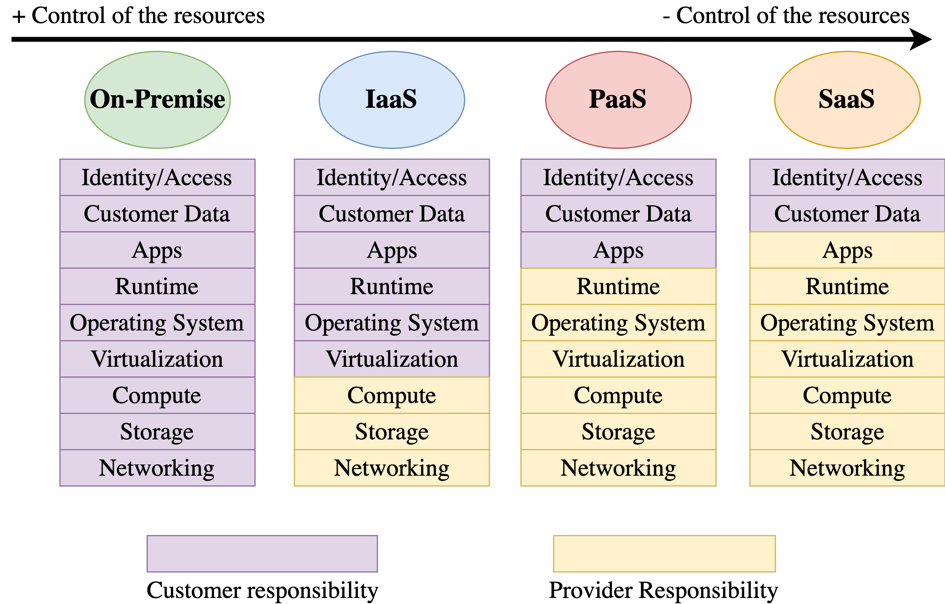
Shared Responsibility Model

Slide 51
Shared Responsibility Model
The shared responsibility model outlines where a cloud provider’s role and responsibility ends and the customer’s begins.

Slide 52
Shared Responsibility Model: Pizza as a Service
The shared responsibility model is like ordering a pizza.

Slide 53
Shared Responsibility Model: Pizza as a Service
The shared responsibility model is like ordering a pizza.
SaaS: Take the pizza in a restaurant. The pizza provider is responsible for everything, you just need to eat the pizza.

Slide 54
Shared Responsibility Model: Pizza as a Service
The shared responsibility model is like ordering a pizza.
SaaS: Take the pizza in a restaurant. The pizza provider is responsible for everything, you just need to eat the pizza.
PaaS: Pizza delivery. The pizza provider is responsible for the baking the pizza and ensuring it arrives to your home. You are responsible for preparaing the table and the drinks.

Slide 55
Shared Responsibility Model: Pizza as a Service
The shared responsibility model is like ordering a pizza.
SaaS: Take the pizza in a restaurant. The pizza provider is responsible for everything, you just need to eat the pizza.
PaaS: Pizza delivery. The pizza provider is responsible for the baking the pizza and ensuring it arrives to your home. You are responsible for preparaing the table and the drinks.
IaaS: Take the pizza home and bake it yourself. You are responsible for the dinning table, the electricity, and the oven. The pizza provider is responsible for the pizza and the box.

Slide 56
Shared Responsibility Model: Pizza as a Service
The shared responsibility model is like ordering a pizza.
SaaS: Take the pizza in a restaurant. The pizza provider is responsible for everything, you just need to eat the pizza.
PaaS: Pizza delivery. The pizza provider is responsible for the baking the pizza and ensuring it arrives to your home. You are responsible for preparaing the table and the drinks.
IaaS: Take the pizza home and bake it yourself. You are responsible for the dinning table, the electricity, and the oven. The pizza provider is responsible for the pizza and the box.
On-premises: You make the pizza at home from scratch. You are responsible for everything, from the ingredients to the baking and for preparing the table and the drinks too.

Slide 57
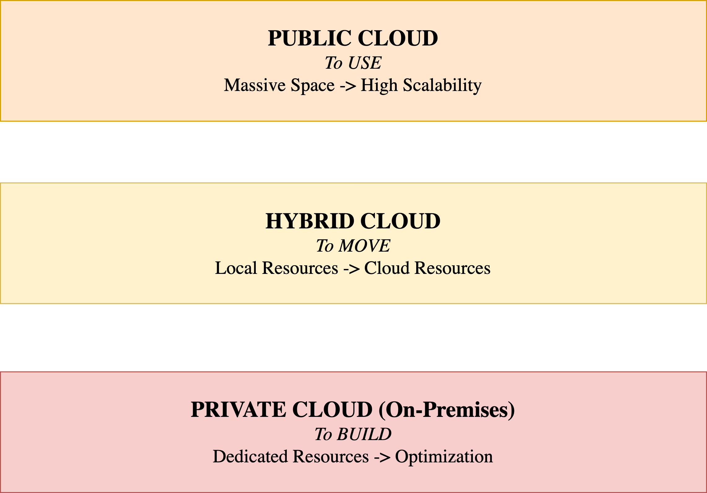
Deployment Models

Slide 58
Public Cloud
The public cloud is defined as computing services offered by third-party providers over the public Internet, making them available to anyone who wants to use or purchase them.

Slide 59
Public Cloud
The public cloud is defined as computing services offered by third-party providers over the public Internet, making them available to anyone who wants to use or purchase them.
Type of cloud computing with resources available to the general public over the internet.

Slide 60
Public Cloud
The public cloud is defined as computing services offered by third-party providers over the public Internet, making them available to anyone who wants to use or purchase them.
Type of cloud computing with resources available to the general public over the internet.
Providers own and manage infrastructure on a pay-as-you-go basis.

Slide 61
Public Cloud
The public cloud is defined as computing services offered by third-party providers over the public Internet, making them available to anyone who wants to use or purchase them.
Type of cloud computing with resources available to the general public over the internet.
Providers own and manage infrastructure on a pay-as-you-go basis.
Highly scalable and flexible, with wide range of services available.

Slide 62
Public Cloud
The public cloud is defined as computing services offered by third-party providers over the public Internet, making them available to anyone who wants to use or purchase them.
Type of cloud computing with resources available to the general public over the internet.
Providers own and manage infrastructure on a pay-as-you-go basis.
Highly scalable and flexible, with wide range of services available.
Major providers include AWS, Azure, and GCP.

Slide 63
Public Cloud
The public cloud is defined as computing services offered by third-party providers over the public Internet, making them available to anyone who wants to use or purchase them.
Type of cloud computing with resources available to the general public over the internet.
Providers own and manage infrastructure on a pay-as-you-go basis.
Highly scalable and flexible, with wide range of services available.
Major providers include AWS, Azure, and GCP.
Popular for its affordability and scalability.

Slide 64
Private Cloud (On-Premises)
Private cloud refers to a model of cloud computing where IT services are provisioned over private IT infrastructure for the dedicated use of a single organization.

Slide 65
Private Cloud (On-Premises)
Private cloud refers to a model of cloud computing where IT services are provisioned over private IT infrastructure for the dedicated use of a single organization.
Type of cloud computing used exclusively by a single organization.

Slide 66
Private Cloud (On-Premises)
Private cloud refers to a model of cloud computing where IT services are provisioned over private IT infrastructure for the dedicated use of a single organization.
Type of cloud computing used exclusively by a single organization.
Provides greater control and customization over infrastructure.

Slide 67
Private Cloud (On-Premises)
Private cloud refers to a model of cloud computing where IT services are provisioned over private IT infrastructure for the dedicated use of a single organization.
Type of cloud computing used exclusively by a single organization.
Provides greater control and customization over infrastructure.
Can be hosted on-premises or by third-party provider.

Slide 68
Private Cloud (On-Premises)
Private cloud refers to a model of cloud computing where IT services are provisioned over private IT infrastructure for the dedicated use of a single organization.
Type of cloud computing used exclusively by a single organization.
Provides greater control and customization over infrastructure.
Can be hosted on-premises or by third-party provider.
Offers enhanced security and is popular in finance, government, and healthcare.

Slide 69
Private Cloud (On-Premises)
Private cloud refers to a model of cloud computing where IT services are provisioned over private IT infrastructure for the dedicated use of a single organization.
Type of cloud computing used exclusively by a single organization.
Provides greater control and customization over infrastructure.
Can be hosted on-premises or by third-party provider.
Offers enhanced security and is popular in finance, government, and healthcare.
More expensive than public cloud but provides greater control and flexibility.

Slide 70
Hybrid Cloud
Hybrid cloud is a computing environment that combines a public cloud and a private cloud by allowing data and applications to be shared between them.

Slide 71
Hybrid Cloud
Hybrid cloud is a computing environment that combines a public cloud and a private cloud by allowing data and applications to be shared between them.
Combines public and private cloud resources.

Slide 72
Hybrid Cloud
Hybrid cloud is a computing environment that combines a public cloud and a private cloud by allowing data and applications to be shared between them.
Combines public and private cloud resources.
Provides cost-effectiveness and scalability of public cloud, while maintaining control over sensitive data in private cloud.

Slide 73
Hybrid Cloud
Hybrid cloud is a computing environment that combines a public cloud and a private cloud by allowing data and applications to be shared between them.
Combines public and private cloud resources.
Provides cost-effectiveness and scalability of public cloud, while maintaining control over sensitive data in private cloud.
Offers greater flexibility and agility, and can optimize computing resources and costs.

Slide 74
Hybrid Cloud
Hybrid cloud is a computing environment that combines a public cloud and a private cloud by allowing data and applications to be shared between them.
Combines public and private cloud resources.
Provides cost-effectiveness and scalability of public cloud, while maintaining control over sensitive data in private cloud.
Offers greater flexibility and agility, and can optimize computing resources and costs.
Complex to set up and manage, requires careful planning and coordination.

Slide 75
Hybrid Cloud
Hybrid cloud is a computing environment that combines a public cloud and a private cloud by allowing data and applications to be shared between them.
Combines public and private cloud resources.
Provides cost-effectiveness and scalability of public cloud, while maintaining control over sensitive data in private cloud.
Offers greater flexibility and agility, and can optimize computing resources and costs.
Complex to set up and manage, requires careful planning and coordination.
Balances benefits of public and private cloud, but requires expertise to manage.

Slide 76
Which is the current situation of Cloud Computing?

Slide 77
Which is the current situation of Cloud Computing?
The global cloud computing market is expected to reach $832.1 billion by 2025, growing at a CAGR of 17.5% from 2020 to 2025.

Slide 78
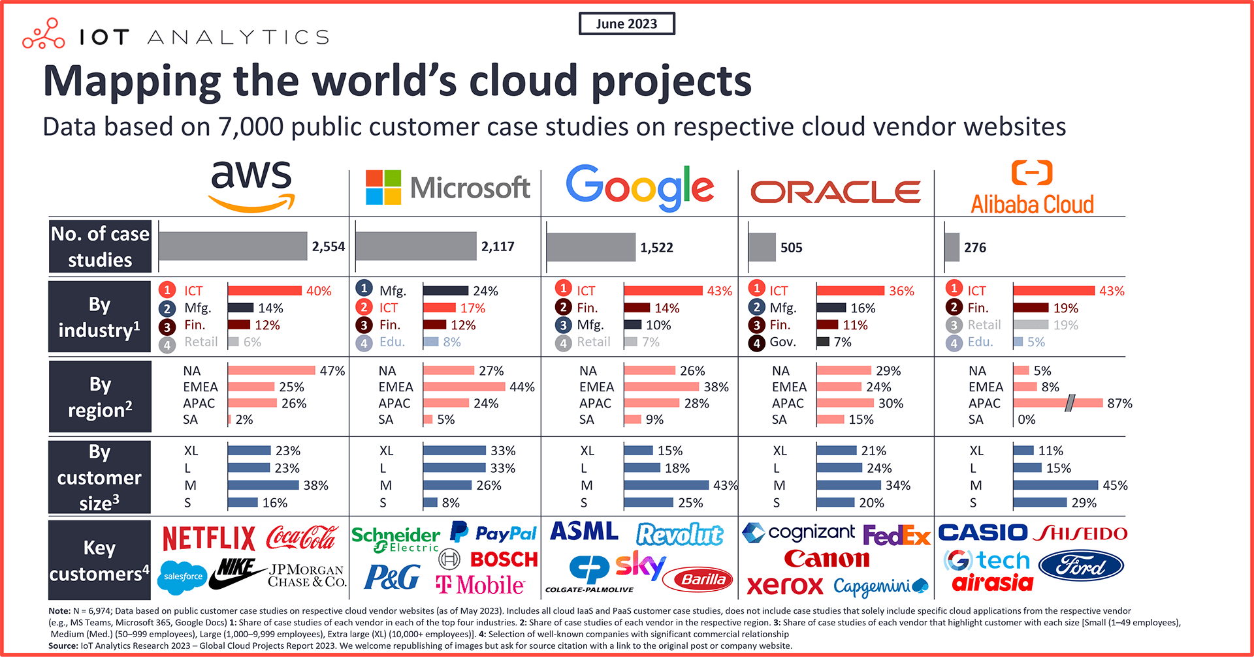
Which is the current situation of Cloud Computing?
The global cloud computing market is expected to reach $832.1 billion by 2025, growing at a CAGR of 17.5% from 2020 to 2025.
Figure 6: Extracted from IoT Analytics

Slide 79
Advantages of Cloud Computing

Slide 80
Capital expeneses to operational expenses
The capital expenses (CapEx) of building and maintaining data centers is converted to operational expenses (OpEx) of renting cloud computing resources.

Slide 81
Capital expeneses to operational expenses
The capital expenses (CapEx) of building and maintaining data centers is converted to operational expenses (OpEx) of renting cloud computing resources.
⇒ This shift reduces the need for large investments in hardware, and provides a more predictable and manageable cost structure.

Slide 82
Capital expeneses to operational expenses
The capital expenses (CapEx) of building and maintaining data centers is converted to operational expenses (OpEx) of renting cloud computing resources.
⇒ This shift reduces the need for large investments in hardware, and provides a more predictable and manageable cost structure.
Example: Hotel Analogy
It is like renting a room in a hotel instead of buying a house. You do not need to invest in the
building, you just pay for the room.

Slide 83
Capital expeneses to operational expenses
The capital expenses (CapEx) of building and maintaining data centers is converted to operational expenses (OpEx) of renting cloud computing resources.
⇒ This shift reduces the need for large investments in hardware, and provides a more predictable and manageable cost structure.
Example: Hotel Analogy
It is like renting a room in a hotel instead of buying a house. You do not need to invest in the
building, you just pay for the room.
Be aware!
In the long term, it is more expensive to rent a room than to buy a house.

Slide 84
Capital expeneses to operational expenses
The capital expenses (CapEx) of building and maintaining data centers is converted to operational expenses (OpEx) of renting cloud computing resources.
⇒ This shift reduces the need for large investments in hardware, and provides a more predictable and manageable cost structure.
Example: Hotel Analogy
It is like renting a room in a hotel instead of buying a house. You do not need to invest in the
building, you just pay for the room.
Be aware!
In the long term, it is more expensive to rent a room than to buy a house.
You only pay for what you use.

Slide 85
Economies of scale
Cloud computing providers benefit from economies of scale, which allows them to offer lower prices than an individual company can achieve. This is because they can buy and manage resources at a larger scale, and then pass the savings.

Slide 86
Economies of scale
Cloud computing providers benefit from economies of scale, which allows them to offer lower prices than an individual company can achieve. This is because they can buy and manage resources at a larger scale, and then pass the savings.
Example: Hotel Analogy
The hotel can buy food and cleaning products in bulk, and obtain better prices than an individual can
achieve.

Slide 87
Economies of scale
Cloud computing providers benefit from economies of scale, which allows them to offer lower prices than an individual company can achieve. This is because they can buy and manage resources at a larger scale, and then pass the savings.
Example: Hotel Analogy
The hotel can buy food and cleaning products in bulk, and obtain better prices than an individual can
achieve.
Aggregated demand from multiple companies can create a more eﬀicient use of resources.

Slide 88
Adaptability and scalability
Cloud computing allows companies to scale up or down as needed. They can stop guessing about their infrastructure needs and scale up or down as the business changes.

Slide 89
Adaptability and scalability
Cloud computing allows companies to scale up or down as needed. They can stop guessing about their infrastructure needs and scale up or down as the business changes.
Example: Hotel Analogy
If you want a suite, you can rent a suite. If you want a single room, you can rent a single room. Each
time you can rent the room that you need. You need more rooms? You can rent more rooms.

Slide 90
Adaptability and scalability
Cloud computing allows companies to scale up or down as needed. They can stop guessing about their infrastructure needs and scale up or down as the business changes.
Example: Hotel Analogy
If you want a suite, you can rent a suite. If you want a single room, you can rent a single room. Each
time you can rent the room that you need. You need more rooms? You can rent more rooms.
You can scale up or down as yout business needed.

Slide 91
Deployment speed
Cloud computing services are provided on demand, so vast amounts of computing resources can be provisioned in minutes. This gives businesses a lot of flexibility and taking the pressure off capacity planning.

Slide 92
Deployment speed
Cloud computing services are provided on demand, so vast amounts of computing resources can be provisioned in minutes. This gives businesses a lot of flexibility and taking the pressure off capacity planning.
Example: Hotel Analogy
You can rent a room in minutes. How long does it take to buy a house?

Slide 93
Deployment speed
Cloud computing services are provided on demand, so vast amounts of computing resources can be provisioned in minutes. This gives businesses a lot of flexibility and taking the pressure off capacity planning.
Example: Hotel Analogy
You can rent a room in minutes. How long does it take to buy a house?
You can get resources in minutes.

Slide 94
Case Study: Dropbox Journey
Dropbox is a file hosting service that offers cloud storage, file synchronization, personal cloud, and client software. It allows users to create a particular folder on their computers, which Dropbox then synchronizes so that it appears to be the same folder (with the same contents) regardless of which device is used to view it.

Slide 95
Case Study: Dropbox Journey
Dropbox is a file hosting service that offers cloud storage, file synchronization, personal cloud, and client software. It allows users to create a particular folder on their computers, which Dropbox then synchronizes so that it appears to be the same folder (with the same contents) regardless of which device is used to view it.
Dropbox using Public Cloud
In its early stages, Dropbox leveraged AWS’s S3
service for file storage. This decision offered Dropbox the ability to:
Rapidly scale storage capacity as user demand increased.
Achieve swift production deployment, enhancing their market responsiveness.

Slide 96
Case Study: Dropbox Journey
Dropbox is a file hosting service that offers cloud storage, file synchronization, personal cloud, and client software. It allows users to create a particular folder on their computers, which Dropbox then synchronizes so that it appears to be the same folder (with the same contents) regardless of which device is used to view it.
Dropbox using Public Cloud
Dropbox migrating to an Hybrid Cloud
In its early stages, Dropbox leveraged AWS’s S3
service for file storage. This decision offered Dropbox the ability to:
Rapidly scale storage capacity as user demand increased.
Achieve swift production deployment, enhancing their market responsiveness.
As Dropbox expanded, the costs associated with
AWS usage escalated. To address this, Dropbox migrated to a hybrid cloud model, which allowed them to:
Maintain control over their growing storage needs while managing costs effectively.
Customize their infrastructure to suit their specific requirements, enhancing eﬀiciency and performance.

Slide 97
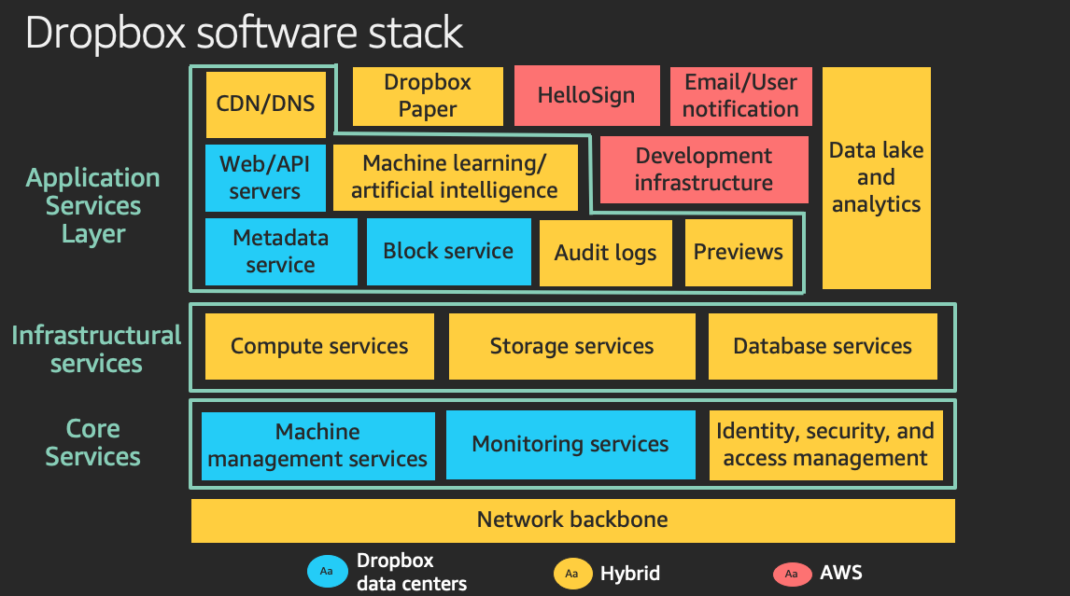
Case Study: Dropbox Today

Slide 98
Risks and Challenges of Cloud Computing

Slide 99
Data security
Cloud computing providers invest heavily in security, but breaches can and do happen. The cloud is not immune to security threats, and companies must carefully manage their security measures.

Slide 100
Data security
Cloud computing providers invest heavily in security, but breaches can and do happen. The cloud is not immune to security threats, and companies must carefully manage their security measures.
Data breaches

Slide 101
Data security
Cloud computing providers invest heavily in security, but breaches can and do happen. The cloud is not immune to security threats, and companies must carefully manage their security measures.
Data breaches
Data compliance

Slide 102
Data security
Cloud computing providers invest heavily in security, but breaches can and do happen. The cloud is not immune to security threats, and companies must carefully manage their security measures.
Data breaches
Data compliance
Misconfiguration

Slide 103
Data security
Cloud computing providers invest heavily in security, but breaches can and do happen. The cloud is not immune to security threats, and companies must carefully manage their security measures.
Data breaches
Data compliance
Misconfiguration
Insider threats

Slide 104
Data security
Cloud computing providers invest heavily in security, but breaches can and do happen. The cloud is not immune to security threats, and companies must carefully manage their security measures.
Data breaches
Data compliance
Misconfiguration
Insider threats
You need to be aware of the security measures of your cloud provider and yours, it is a shared responsibility.

Slide 105
Real Cases of Security Breaches
WannaCry ransomware attack in 2017 affected more than 200,000 computers in 150 countries, including the UK’s National Health Service (NHS). The attack encrypted data on computers and demanded a ransom to unlock it.

Slide 106
Real Cases of Security Breaches
WannaCry ransomware attack in 2017 affected more than 200,000 computers in 150 countries, including the UK’s National Health Service (NHS). The attack encrypted data on computers and demanded a ransom to unlock it.
In 2021, Universitat Autònoma de Barcelona (UAB) suffered a data breach that exposed the personal information of students and staff. The breach occurred when a hacker gained unauthorized access to the university’s computer systems and stole sensitive data.

Slide 107
Real Cases of Security Breaches
WannaCry ransomware attack in 2017 affected more than 200,000 computers in 150 countries, including the UK’s National Health Service (NHS). The attack encrypted data on computers and demanded a ransom to unlock it.
In 2021, Universitat Autònoma de Barcelona (UAB) suffered a data breach that exposed the personal information of students and staff. The breach occurred when a hacker gained unauthorized access to the university’s computer systems and stole sensitive data.
In 2023, the Clinic Barcelona Hospital suffered a data breach that exposed the personal information of million of patients. The breach occurred when a subcontractor accidentally uploaded patient data to the internet without proper security measures.

Slide 108
Have I Been Pwned?
Have I Been Pwned is a website that allows internet users to check if their personal data has been compromised by data breaches. The service collects and analyzes hundreds of database dumps and pastes containing information about billions of leaked accounts, and allows users to search for their own data by entering their username or email address.

Slide 109
Have I Been Pwned?
Have I Been Pwned is a website that allows internet users to check if their personal data has been compromised by data breaches. The service collects and analyzes hundreds of database dumps and pastes containing information about billions of leaked accounts, and allows users to search for their own data by entering their username or email address.
Have you been pwned?

Slide 110
How to protect your data in the cloud?
Data encryption: Encrypt data at rest and in transit to protect it from unauthorized access.

Slide 111
How to protect your data in the cloud?
Data encryption: Encrypt data at rest and in transit to protect it from unauthorized access.
Access control: Implement strong access controls to ensure that only authorized users can access data.

Slide 112
How to protect your data in the cloud?
Data encryption: Encrypt data at rest and in transit to protect it from unauthorized access.
Access control: Implement strong access controls to ensure that only authorized users can access data.
Data backup: Regularly back up data to ensure that it can be recovered in the event of data loss or corruption.

Slide 113
How to protect your data in the cloud?
Data encryption: Encrypt data at rest and in transit to protect it from unauthorized access.
Access control: Implement strong access controls to ensure that only authorized users can access data.
Data backup: Regularly back up data to ensure that it can be recovered in the event of data loss or corruption.
Security monitoring: Monitor cloud environments for security threats and respond to incidents in a timely manner.

Slide 114
How to protect your data in the cloud?
Data encryption: Encrypt data at rest and in transit to protect it from unauthorized access.
Access control: Implement strong access controls to ensure that only authorized users can access data.
Data backup: Regularly back up data to ensure that it can be recovered in the event of data loss or corruption.
Security monitoring: Monitor cloud environments for security threats and respond to incidents in a timely manner.
Compliance: Ensure that cloud environments comply with relevant security standards and regulations.

Slide 115
Data compliance
Regulatory compliance is a critical consideration for companies that store and process sensitive data in the cloud. Companies need to ensure that their cloud environments comply with relevant security standards and regulations, such as GDPR, HIPAA, and PCI DSS.

Slide 116
Data compliance
Regulatory compliance is a critical consideration for companies that store and process sensitive data in the cloud. Companies need to ensure that their cloud environments comply with relevant security standards and regulations, such as GDPR, HIPAA, and PCI DSS.
You need to be aware of the data compliance regulations that apply to your business.

Slide 117
Lock-in
Cloud providers use proprietary technology, which can make it diﬀicult to migrate data and applications to other cloud providers. This can result in vendor lock-in, where companies are dependent on a single cloud provider for their computing needs.

Slide 118
Lock-in
Cloud providers use proprietary technology, which can make it diﬀicult to migrate data and applications to other cloud providers. This can result in vendor lock-in, where companies are dependent on a single cloud provider for their computing needs.
Limited flexibility and choice: Customers may be limited in their ability to choose different vendors or solutions that better meet their evolving needs or provide better value.

Slide 119
Lock-in
Cloud providers use proprietary technology, which can make it diﬀicult to migrate data and applications to other cloud providers. This can result in vendor lock-in, where companies are dependent on a single cloud provider for their computing needs.
Limited flexibility and choice: Customers may be limited in their ability to choose different vendors or solutions that better meet their evolving needs or provide better value.
Higher switching costs: Customers may face high costs and complexity when migrating their data, applications, or services to a different cloud vendor or on-premises environment.

Slide 120
Lock-in
Cloud providers use proprietary technology, which can make it diﬀicult to migrate data and applications to other cloud providers. This can result in vendor lock-in, where companies are dependent on a single cloud provider for their computing needs.
Limited flexibility and choice: Customers may be limited in their ability to choose different vendors or solutions that better meet their evolving needs or provide better value.
Higher switching costs: Customers may face high costs and complexity when migrating their data, applications, or services to a different cloud vendor or on-premises environment.
Data interoperability: Customers may face challenges in ensuring data interoperability and portability across different cloud platforms or environments, which can hinder their ability to integrate or share data with other applications or systems.

Slide 121
Lock-in
Cloud providers use proprietary technology, which can make it diﬀicult to migrate data and applications to other cloud providers. This can result in vendor lock-in, where companies are dependent on a single cloud provider for their computing needs.
Limited flexibility and choice: Customers may be limited in their ability to choose different vendors or solutions that better meet their evolving needs or provide better value.
Higher switching costs: Customers may face high costs and complexity when migrating their data, applications, or services to a different cloud vendor or on-premises environment.
Data interoperability: Customers may face challenges in ensuring data interoperability and portability across different cloud platforms or environments, which can hinder their ability to integrate or share data with other applications or systems.
There are several strategies to mitigate the risks of vendor lock-in, such as using open standards and APIs, adopting a multi-cloud or hybrid cloud strategy. For instance, VMWare provides a multi-cloud strategy that allows customers to run applications across multiple cloud environments, including AWS, Azure, and GCP.

Slide 122
Other challenges
Performance: Can be affected by factors such as network latency, bandwidth, and the location of data centers.

Slide 123
Other challenges
Performance: Can be affected by factors such as network latency, bandwidth, and the location of data centers.
Cost management: Cloud costs can spiral out of control if not properly managed, leading to unexpected expenses.

Slide 124
Other challenges
Performance: Can be affected by factors such as network latency, bandwidth, and the location of data centers.
Cost management: Cloud costs can spiral out of control if not properly managed, leading to unexpected expenses.
Service level agreements (SLAs): Cloud providers may not meet their SLAs, leading to downtime or performance issues.

Slide 125
Other challenges
Performance: Can be affected by factors such as network latency, bandwidth, and the location of data centers.
Cost management: Cloud costs can spiral out of control if not properly managed, leading to unexpected expenses.
Service level agreements (SLAs): Cloud providers may not meet their SLAs, leading to downtime or performance issues.
Integrity: Ensuring the integrity of data and applications in the cloud, and protecting against unauthorized changes or tampering.

Slide 126
Other challenges
Performance: Can be affected by factors such as network latency, bandwidth, and the location of data centers.
Cost management: Cloud costs can spiral out of control if not properly managed, leading to unexpected expenses.
Service level agreements (SLAs): Cloud providers may not meet their SLAs, leading to downtime or performance issues.
Integrity: Ensuring the integrity of data and applications in the cloud, and protecting against unauthorized changes or tampering.
Real-time data processing: Cloud environments may not be optimized for real-time data processing and analysis, which can impact the performance of applications that require low latency and high throughput.

Slide 127
Other challenges
Performance: Can be affected by factors such as network latency, bandwidth, and the location of data centers.
Cost management: Cloud costs can spiral out of control if not properly managed, leading to unexpected expenses.
Service level agreements (SLAs): Cloud providers may not meet their SLAs, leading to downtime or performance issues.
Integrity: Ensuring the integrity of data and applications in the cloud, and protecting against unauthorized changes or tampering.
Real-time data processing: Cloud environments may not be optimized for real-time data processing and analysis, which can impact the performance of applications that require low latency and high throughput.
Cloud computing is not without its risks and challenges, and companies need to carefully manage these to ensure a successful cloud deployment.

Slide 128
Homework
I want you to create a GitHub account. Next week we are going to create a personal website using
GitHub Pages. Take a look at the lab descripton if you want.

Slide 129
Case Study: Is Cloud Computing Right for Your Company? (I)
Consider a startup company X. The company is in a competitive market and needs to reduce costs and time to market. The company is considering whether to adopt cloud computing or traditional infrastructure?

Slide 130
Case Study: Is Cloud Computing Right for Your Company? (I)
Consider a startup company X. The company is in a competitive market and needs to reduce costs and time to market. The company is considering whether to adopt cloud computing or traditional infrastructure?
The company can leverage cloud computing to reduce costs and time to market, while also benefiting from the flexibility and scalability of cloud resources. For instance, Amazon Web Services (AWS) offers a pay-as-you-go model that allows startups to only pay for the services they use.

Slide 131
Case Study: Is Cloud Computing Right for Your Company? (II)
Now, consider a small company Y that needs to digitalize its business and reduce costs to compete effectively in the market. The company is also considering whether to adopt cloud computing or traditional infrastructure.

Slide 132
Case Study: Is Cloud Computing Right for Your Company? (II)
Now, consider a small company Y that needs to digitalize its business and reduce costs to compete effectively in the market. The company is also considering whether to adopt cloud computing or traditional infrastructure.
The decision depends on the specific needs and resources of the company. If the company has a significant amount of sensitive data, a traditional infrastructure might be more suitable due to the increased control over data security. However, if the company values flexibility and scalability, cloud computing could be a better choice.

Slide 133
Case Study: Is Cloud Computing Right for Your Company? (III)
Fast forward a few years, and company X has achieved remarkable success. The company has grown significantly and its needs have evolved.

Slide 134
Case Study: Is Cloud Computing Right for Your Company? (III)
Fast forward a few years, and company X has achieved remarkable success. The company has grown significantly and its needs have evolved.
The cost of using public cloud services increases as the company grows, but the company can now afford to invest in a private cloud. At this point, a hybrid cloud solution can help to balance between the advantages of public and private clouds. For example, Microsoft Azure offers hybrid cloud solutions that combine the best of both worlds.

Slide 135
Case Study: Is Cloud Computing Right for Your Company? (III)
Fast forward a few years, and company X has achieved remarkable success. The company has grown significantly and its needs have evolved.
The cost of using public cloud services increases as the company grows, but the company can now afford to invest in a private cloud. At this point, a hybrid cloud solution can help to balance between the advantages of public and private clouds. For example, Microsoft Azure offers hybrid cloud solutions that combine the best of both worlds.
Take Home Message
There’s no one-size-fits-all answer when it comes to choosing between Cloud or Traditional
infrastructure. The optimal solution hinges on the specific needs and resources of the company. A thorough analysis of the costs, benefits, and potential risks associated with each option is crucial to making an informed decision.

Slide 136
Cloud Computing in Health

Slide 137
Why Cloud Computing in Health?
Big Data: Manage and store large volumes of data, including patient records, medical images, and other health information.

Slide 138
Why Cloud Computing in Health?
Big Data: Manage and store large volumes of data, including patient records, medical images, and other health information.
Interoperability: Share data across different systems and platforms, improving communication and collaboration among providers.

Slide 139
Why Cloud Computing in Health?
Big Data: Manage and store large volumes of data, including patient records, medical images, and other health information.
Interoperability: Share data across different systems and platforms, improving communication and collaboration among providers.
Digital Transformation: Adopt new technologies and services, such as telemedicine, remote monitoring, mobile health apps or electronic health records.

Slide 140
Why Cloud Computing in Health?
Big Data: Manage and store large volumes of data, including patient records, medical images, and other health information.
Interoperability: Share data across different systems and platforms, improving communication and collaboration among providers.
Digital Transformation: Adopt new technologies and services, such as telemedicine, remote monitoring, mobile health apps or electronic health records.
In his PhD thesis, Management of Cloud Systems Applied to eHealth, (Vilaplana Mayoral et al. 2015) conducts a comprehensive analysis of the adoption of cloud computing within the healthcare sector. He implemented various cloud-based tools for telemedicine and remote patient monitoring, highlighting their transformative impact on healthcare delivery.

Slide 141
Which are the opportunities of Cloud Computing in Health?
Capital expenses savings
Healthcare organitzation can rent computing resources on a pay-as-you-go basis, reducing the need
for large upfront investments in expensive hardware and software.

Slide 142
Which are the opportunities of Cloud Computing in Health?
Capital expenses savings
Healthcare organitzation can rent computing resources on a pay-as-you-go basis, reducing the need
for large upfront investments in expensive hardware and software.
Improved patient care and decision making
Healthcare professionals can store and analyze large volumes of data to build predictive and
prescriptive models, improving patient care and decision making.

Slide 143
Which are the opportunities of Cloud Computing in Health?
Capital expenses savings
Healthcare organitzation can rent computing resources on a pay-as-you-go basis, reducing the need
for large upfront investments in expensive hardware and software.
Improved patient care and decision making
Healthcare professionals can store and analyze large volumes of data to build predictive and
prescriptive models, improving patient care and decision making.
Better coordination among stakeholders
Patients and healthcare professionals can access and share data more easily.

Slide 144
Which are the opportunities of Cloud Computing in Health?
Capital expenses savings
Healthcare organitzation can rent computing resources on a pay-as-you-go basis, reducing the need
for large upfront investments in expensive hardware and software.
Improved patient care and decision making
Healthcare professionals can store and analyze large volumes of data to build predictive and
prescriptive models, improving patient care and decision making.
Better coordination among stakeholders
Patients and healthcare professionals can access and share data more easily.
More opportunities in the healthcare sector are discussed in (Ali et al. 2018).

Slide 145
Use Cases
Sequence Analysis: AWS offers services like AWS Lambda and Amazon S3 that can be used to run sequence analysis software like BLAST. This allows healthcare organizations to compare patient DNA sequences with known sequences to identify genetic mutations.

Slide 146
Use Cases
Sequence Analysis: AWS offers services like AWS Lambda and Amazon S3 that can be used to run sequence analysis software like BLAST. This allows healthcare organizations to compare patient DNA sequences with known sequences to identify genetic mutations.
Genomic Data Storage: Google Cloud Platform (GCP) provides a solution for storing genomic data. It offers services like Google Cloud Storage and BigQuery which can be used to store and analyze large volumes of genomic data.

Slide 147
Use Cases
Sequence Analysis: AWS offers services like AWS Lambda and Amazon S3 that can be used to run sequence analysis software like BLAST. This allows healthcare organizations to compare patient DNA sequences with known sequences to identify genetic mutations.
Genomic Data Storage: Google Cloud Platform (GCP) provides a solution for storing genomic data. It offers services like Google Cloud Storage and BigQuery which can be used to store and analyze large volumes of genomic data.
Telemedicine: Microsoft Azure has a service called Azure Communication Services that can be used to build telemedicine applications. It provides capabilities for video calling, chat, and SMS, enabling healthcare providers to consult with patients remotely.

Slide 148
Use Cases
Sequence Analysis: AWS offers services like AWS Lambda and Amazon S3 that can be used to run sequence analysis software like BLAST. This allows healthcare organizations to compare patient DNA sequences with known sequences to identify genetic mutations.
Genomic Data Storage: Google Cloud Platform (GCP) provides a solution for storing genomic data. It offers services like Google Cloud Storage and BigQuery which can be used to store and analyze large volumes of genomic data.
Telemedicine: Microsoft Azure has a service called Azure Communication Services that can be used to build telemedicine applications. It provides capabilities for video calling, chat, and SMS, enabling healthcare providers to consult with patients remotely.
Remote Patient Monitoring: IBM Watson Health offers solutions for remote patient monitoring. It uses AI to analyze data from various sources such as electronic health records and wearable devices, providing healthcare professionals with insights to improve patient care.

Slide 149
Challenges in Health
Security and Privacy: Healthcare organizations are obligated to adhere to stringent regulations and standards to safeguard patient data. LOPD in Spain or HIPAA in the United States mandate the protection of personal data and guarantees digital rights

Slide 150
Challenges in Health
Security and Privacy: Healthcare organizations are obligated to adhere to stringent regulations and standards to safeguard patient data. LOPD in Spain or HIPAA in the United States mandate the protection of personal data and guarantees digital rights
Data Integration: Healthcare organizations are required to integrate data from diverse sources and systems to deliver comprehensive care. This integration is crucial in transforming isolated information units into a unified system of knowledge and action. However, achieving seamless data integration in healthcare is a significant challenge. For instance, the integration of Electronic Health Records (EHRs) with telemedicine platforms provides clinicians with comprehensive patient data during consultations, but it is a complex process.

Slide 151
Is cloud computing the future of Health?
No, cloud computing is not the future of health, it is the present and it is an essential part of the future.

Slide 152
Is cloud computing the future of Health?
No, cloud computing is not the future of health, it is the present and it is an essential part of the future.
Cloud Computing ⇒ Continuum

Slide 153
Is cloud computing the future of Health?
No, cloud computing is not the future of health, it is the present and it is an essential part of the future.
Cloud Computing ⇒ Continuum
IoT devices: Sensors, wearables, and other devices that collect and transmit data.

Slide 154
Is cloud computing the future of Health?
No, cloud computing is not the future of health, it is the present and it is an essential part of the future.
Cloud Computing ⇒ Continuum
IoT devices: Sensors, wearables, and other devices that collect and transmit data.
Mobile devices: Smartphones and tablets that can be used to access and share data.

Slide 155
Is cloud computing the future of Health?
No, cloud computing is not the future of health, it is the present and it is an essential part of the future.
Cloud Computing ⇒ Continuum
IoT devices: Sensors, wearables, and other devices that collect and transmit data.
Mobile devices: Smartphones and tablets that can be used to access and share data.
Edge computing: Facilitates real-time data processing and analysis at the source of data generation.

Slide 156
Is cloud computing the future of Health?
No, cloud computing is not the future of health, it is the present and it is an essential part of the future.
Cloud Computing ⇒ Continuum
IoT devices: Sensors, wearables, and other devices that collect and transmit data.
Mobile devices: Smartphones and tablets that can be used to access and share data.
Edge computing: Facilitates real-time data processing and analysis at the source of data generation.
Fog computing: Extends cloud computing to the edge of the network to improve eﬀiciency and reduce latency.

Slide 157
Is cloud computing the future of Health?
No, cloud computing is not the future of health, it is the present and it is an essential part of the future.
Cloud Computing ⇒ Continuum
IoT devices: Sensors, wearables, and other devices that collect and transmit data.
Mobile devices: Smartphones and tablets that can be used to access and share data.
Edge computing: Facilitates real-time data processing and analysis at the source of data generation.
Fog computing: Extends cloud computing to the edge of the network to improve eﬀiciency and reduce latency.
Big ⇒ Quality

Slide 158
Is cloud computing the future of Health?
No, cloud computing is not the future of health, it is the present and it is an essential part of the future.
Cloud Computing ⇒ Continuum
IoT devices: Sensors, wearables, and other devices that collect and transmit data.
Mobile devices: Smartphones and tablets that can be used to access and share data.
Edge computing: Facilitates real-time data processing and analysis at the source of data generation.
Fog computing: Extends cloud computing to the edge of the network to improve eﬀiciency and reduce latency.
Big ⇒ Quality
There is a growing demand for high-quality data in healthcare. Cloud computing can help healthcare organizations manage and analyze large volumes of data to improve patient care and outcomes. But it is not only about the quantity of data, it is about the quality of the data. Distributed Artificial Intelligence can help to analyze data and identify patterns and trends in real time.

Slide 159
Conclusion

Slide 160
Recap: Cloud Computing vs Traditional Computing
Cloud Computing
Pay what you use
No server space needed
No expertes required for hardware and software maintenance
Disaster recovery
High flexibility
Automated software updates
Teams can collaborate from different locations
Data can be accessed and shared from anywhere
Rapid implementation
Traditional
Costly and less scalable
Space needed for the servers
Hardware and software team for maintenance
Less flexibility
No automated updates
Less collaboration
Data cannot be accessed remotely
Takes long time for implementation

Slide 161
Tasks

Slide 162
Homework - Creating our own website
HandsOnLab01: Deploying your personal website
The goal of this hands-on lab is to show you how to deploy a personal website using cloud computing.
For this hands-on lab, you will need to follow the instructions: HOL01

Slide 163
Homework - Creating our own website
HandsOnLab01: Deploying your personal website
The goal of this hands-on lab is to show you how to deploy a personal website using cloud computing.
For this hands-on lab, you will need to follow the instructions: HOL01
Cloud Computing Fundamentals Quiz: This quiz will test your understanding of the fundamental concepts of cloud computing. Quiz.

Slide 164
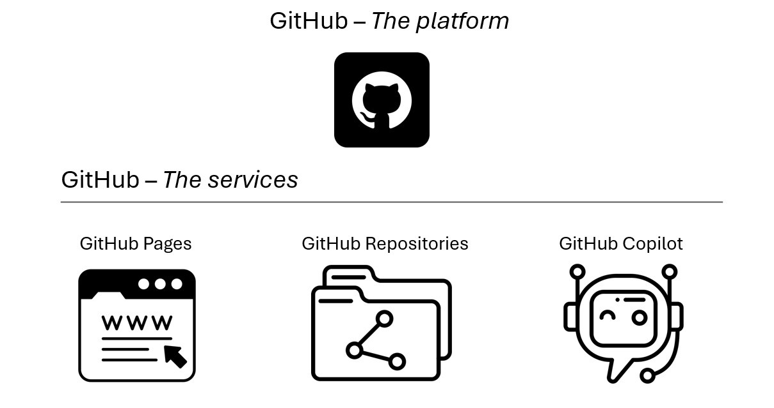
Is GitHub a PaaS, IaaS, or SaaS?
Figure 7: Some of the services GitHub offers

Slide 165
Is GitHub a PaaS, IaaS, or SaaS?
Figure 7: Some of the services GitHub offers

Slide 166
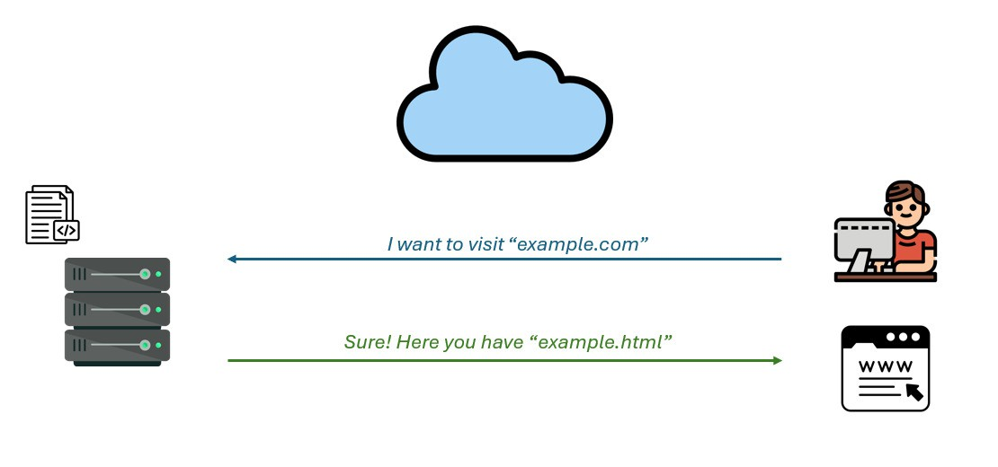
What does it mean to host a website?
Figure 8: What happens when I want to visit a website?

Slide 167
Let’s recap
On my computer
I have to download a repository
I have to install software to build the website
I have to install software to serve the website
I have to edit the files
I have to build the website
I have to serve the website
Result? A website accessible only from my computer only while the software is running
With GitHub Pages
Fork a repository
Tweak some settings
Edit the files
Commit the changes
Result? A free website accessible from anywhere

Slide 168
References
Ali, Omar, Anup Shrestha, Jeffrey Soar, and Samuel Fosso Wamba. 2018. “Cloud Computing-Enabled Healthcare Opportunities, Issues, and Applications: A Systematic Review.” International Journal of Information Management 43: 146–58.
Mell, Peter, Tim Grance, et al. 2011. “The NIST Definition of Cloud Computing.”
Vilaplana Mayoral, Jordi et al. 2015. Management of Cloud Systems Applied to eHealth. Universitat de Lleida.

